Slide 1


Projeto Teórico Data and Knowledge Management
SINFE-Sistemas de informações empresariais
João Figueiredo 1230194 Tiago Nora 1201050

Slide 2

Index
Opening Case
Introduction
Managing Data
The Database Approach
Big Data
Data warehouses and data marts
Knowledge management

Slide 3

Opening case Our Genetic Data: A Double-Edged Sword
Brief story about data and it’s use.
Personal data sensitivity
Genetic Data Emergence
Direct-to-Consumer Genetic Testing Trend
GEDmatch and Genetic Genealogy

Slide 4

Opening case, Our Genetic Data: A Double-Edged Sword Personal Data sensitivity
Personal data -> any information that refers to an identifiable individual, such as:
Name
Phone number
Social Security numbers
Social Media activity
Location Data
Etc
Is this data ours and only ours?
Short answer: No!
Multiple entities have access to it.

Slide 5

Opening case, Our Genetic Data: A Double-Edged Sword Rise of Genetic Data
Genetic data is the most personal type, located in DNA or RNA, comprising our unique genome.
Used to solve Crimes.
Issues:
Who collects it?
who possesses it?
what is it used for?
Direct-to-consumer (DTC) genetic testing gaining popularity, offering insights into ancestry and health risks.

Slide 6

Opening case, Our Genetic Data: A Double-Edged Sword Impact of DTC Testing and GEDmacth
DTC testing allows consumers to access genetic information without involving healthcare professionals.
Over 12 million people have utilized DTC services like 23andMe.
GEDmatch, founded in 2010, facilitates genealogical research and DNA profile matching, with over 1 million profiles uploaded by 2019.

Slide 7
Index
Opening Case
Introduction
Managing Data
The Database Approach
Big Data
Data warehouses and data marts
Knowledge management

Slide 8

Introduction Information technology
Information technologies and systems are important as they support organizations in managing Data
Acquiring
Storing
Accessing
Analyzing
Interpreting

Slide 9

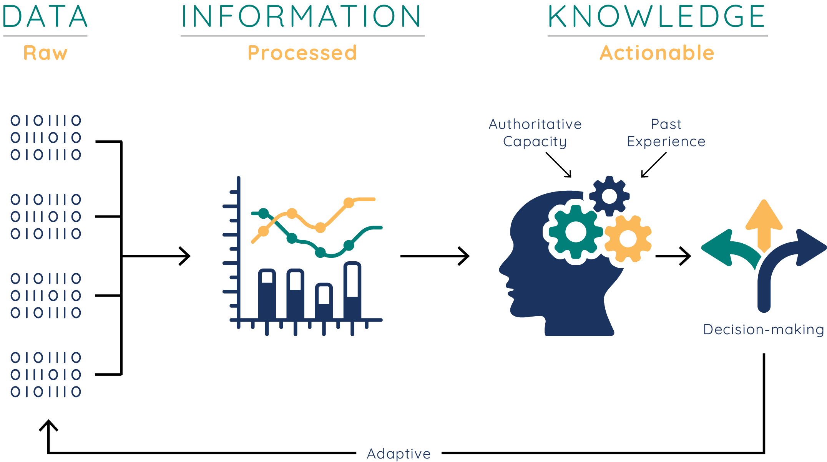
Introduction Importance of Data
Data is the key to information and knowledge, which is crucial for organizations and in decision-making scenarios

Slide 10

Introduction Consequences of poor data management
Missed opportunities
Increased costs
Bad decisions
Decreased Trust
Data decay
Poor design for data storage systems
Database, data warehouses, …

Slide 11
Index
Opening Case
Introduction
Managing Data
The Database Approach
Big Data
Data warehouses and data marts
Knowledge management

Slide 12

Managing data
All IT applications require data. These data should be of high quality, meaning that they should be accurate, complete, timely, consistent, accessible, relevant, and concise. Unfortunately, the process of acquiring, keeping, and managing data is becoming increasingly difficult.

Slide 13
Managing Data: Difficulties of Managing Data
Amount of data increases rapidily and at vast rates.
Data is scattered throughout the organizations
Data generation sources
Data Rot
Data security
Regulations

Slide 14
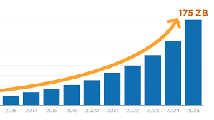
Difficulties of Managing Data: Data proliferation accelerates exponentially.
The sheer volume and diversity of data pose significant challenges for storage, organization, and retrieval.
Ensuring data quality and integrity becomes increasingly complex as the volume of data grows.
Scalability issues arise when traditional data management systems struggle to handle the massive influx of information.
Data governance and compliance become more intricate as regulations evolve and data sources multiply.
Extracting meaningful insights from large datasets requires sophisticated analytical tools and expertise, adding to the complexity of data management.

Slide 15
Difficulties of Managing Data Data is scattered throughout the organizations
Data silos within organizations hinder seamless collaboration and decision-making across departments.
Inefficient data sharing practices result in duplicated efforts and inconsistencies in information.
Lack of centralized data management leads to difficulties in maintaining data integrity and security.
Extracting comprehensive insights from fragmented data sources becomes challenging, limiting the organization's ability to derive value from its data assets.
Implementing integrated data management strategies is essential to overcome the fragmentation and realize the full potential of organizational data.

Slide 16
Difficulties of Managing Data Data generation sources
Data generation sources encompass a wide array of sources, including digital devices, IoT sensors, social media platforms, and online transactions.
The proliferation of smartphones, wearables, and smart appliances contributes significantly to the diversity and volume of generated data.
Social media platforms generate vast amounts of user-generated content, including text, images, and videos, adding to the data deluge.
Machine-generated data from sensors embedded in various devices and equipment provides real-time insights into processes and environments.
Online transactions, including e-commerce purchases, banking activities, and digital interactions, generate substantial data streams that fuel business operations and analytics.

Slide 17
Difficulties of Managing Data Data Rot/Decay
It refers to the gradual degradation or loss of data integrity over time.
Factors contributing to data rot include hardware failures, software obsolescence, and natural degradation of storage media.
Without proper maintenance and periodic checks, data rot can lead to irretrievable loss of valuable information.
Data rot poses significant risks to long-term data preservation efforts, particularly for archival and historical data.
Mitigating data rot requires proactive measures such as regular backups, data migration to modern storage formats, and adherence to best practices in data management and preservation.

Slide 18
Difficulties of Managing Data Data Security
Data security encompasses measures and protocols designed to protect digital information from unauthorized access, theft, or alteration.
Threats to data security include cyberattacks, insider threats, and accidental data breaches.
Encryption techniques play a crucial role in safeguarding data during transmission and storage, rendering it unreadable to unauthorized users.
Access control mechanisms, such as user authentication and authorization, help enforce the principle of least privilege and limit access to sensitive data.
Regular security audits, vulnerability assessments, and employee training programs are essential components of a comprehensive data security strategy.

Slide 19
Difficulties of Managing Data Regulations
Data regulations, such as GDPR in Europe and CCPA in California, impose legal obligations on organizations regarding the collection, processing, and protection of personal data.
Compliance with data regulations is essential to avoid legal consequences, including hefty fines and reputational damage.
Data regulations often require organizations to obtain explicit consent from individuals before collecting and processing their personal information.
Regulatory requirements may include data breach notification obligations, mandating organizations to report security incidents to relevant authorities and affected individuals.
Data regulations are evolving continuously in response to technological advancements and changing privacy concerns, necessitating ongoing compliance efforts by organizations.

Slide 20

Managing Data What to do with all the data?
Enigma's Data Integration and Analytics Platform
Industry Applications of Enigma's Machine Learning Algorithms
Contributions to Social Causes and Privacy Initiatives
Growth and Impact

Slide 21
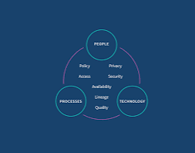
Managing Data Data Governance
Data governance is an approach to managing information across na entire organization
Setting internal standards—data policies—that apply to how data is gathered, stored, processed, and disposed of.
Master Data Management is the way to implement this

Slide 22
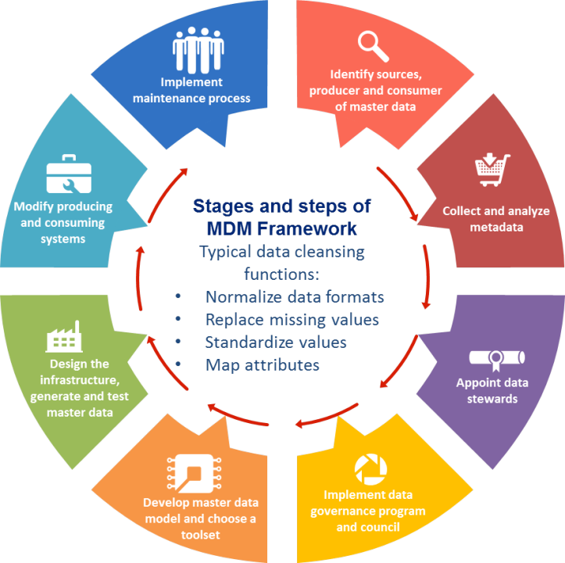
Data Governance Master Data Management
It provides companies with the ability to store, maintain, Exchange and synchronize a consistent, accurate, and timely “single version of the truth” for the company’s master data

Slide 23
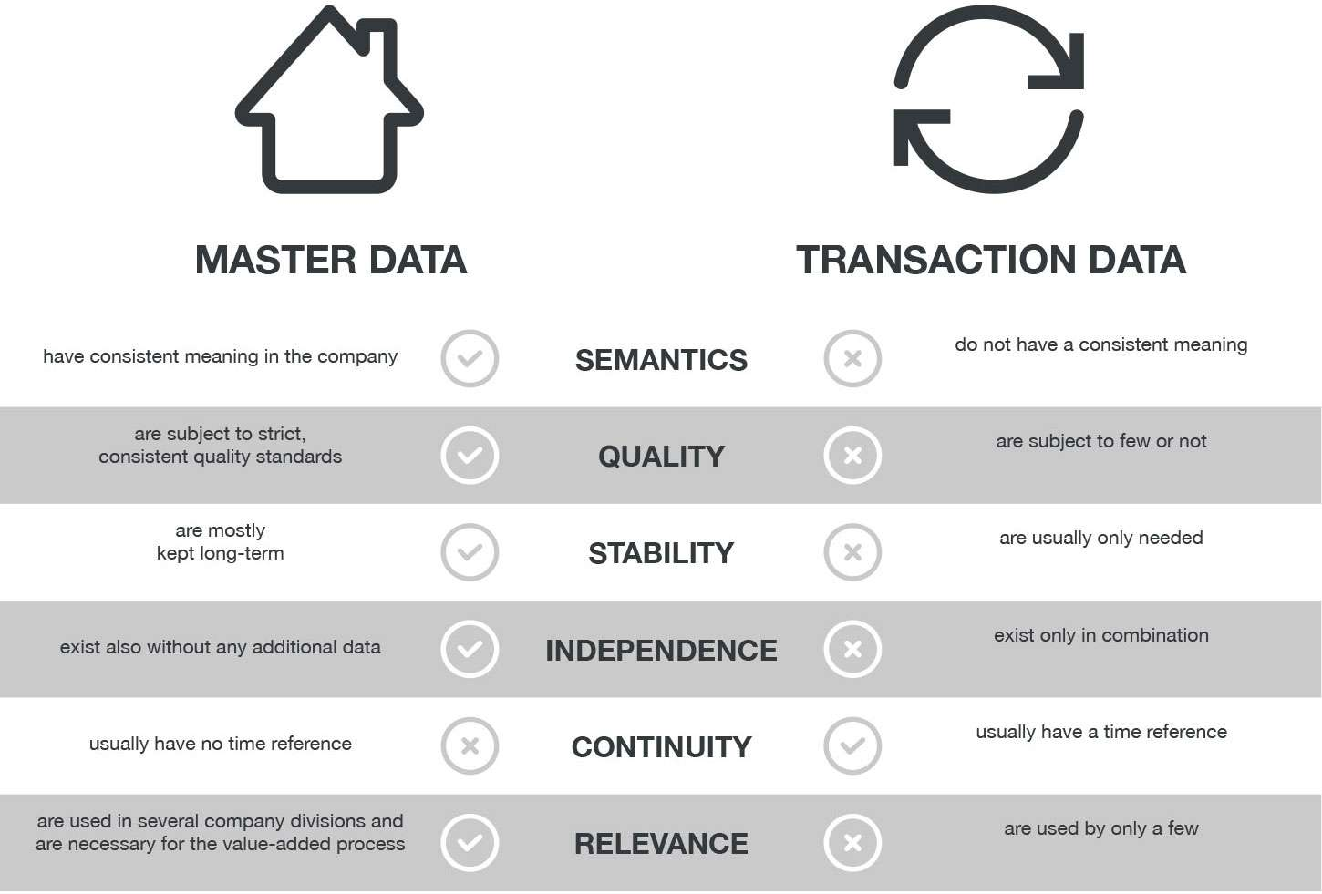
Data Governance Master Data vs Transactional data

Slide 24
Index
Opening Case
Introduction
Managing Data
The Database Approach
Big Data
Data warehouses and data marts
Knowledge management

Slide 25
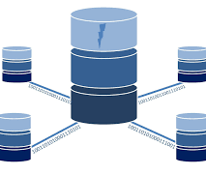
The database approach Emergence of databases
Data syncronization was done on files
It caused problems such as:
Data redudancy
Data isolation
Data inconsistency
A better way must be developed
Databases

Slide 26
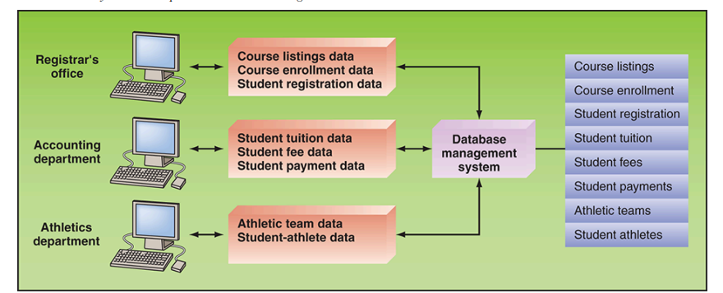
The database approach Databases
Organized collections of related data files or tables, crucial for storing, managing, and accessing data within organizations

Slide 27

The database approach Databases - Advantages
Databases help minimize:
Data isolation
Data redudancy
Data inconsistency
In contrast, they also maximize:
Data security
Data integrity
Data independence

Slide 28
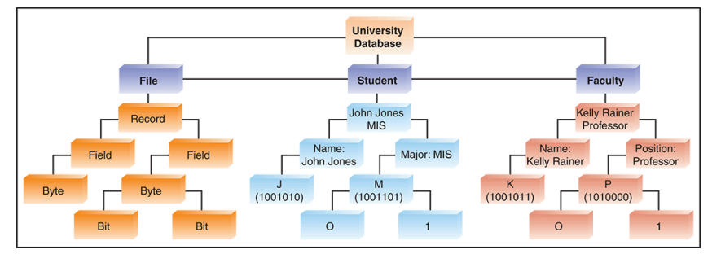
The database approach Data hiearchy
Data are organized from bits to databases, with bits being the smallest unit, bytes representing characters, fields grouping characters, records grouping related fields, and databases grouping related records and files.

Slide 29
The database approach The relational database model
Database Management Systems (DBMS)
Definition: A set of programs facilitating database creation, management, and access
Functions: Adding, deleting, modifying, accessing, and analyzing stored data
Importance: Vital for maintaining data integrity, security, and efficient data retrieval
Relational Database Model
Concept: Organizes data into tables with rows representing entities and columns representing attributes.
Benefits: Reduces data redundancy, simplifies data organization, and ensures easy data retrieval and manipulation.
Examples: Microsoft Access and Oracle are popular implementations of the relational model.
Keys in Databases
Primary Key: Uniquely identifies each record in a table, essential for data retrieval and updates.
Foreign Key: Establishes relationships between tables by referencing the primary key of another table.
Importance: Ensures data integrity and enables efficient data querying and analysis.
Database Operations
Query Languages: Tools for retrieving specific data from a database based on user-defined criteria.
Normalization: Process of organizing data to minimize redundancy and dependency.
Joins: Technique for combining data from multiple tables based on common attributes, facilitating complex data analysis.

Slide 30
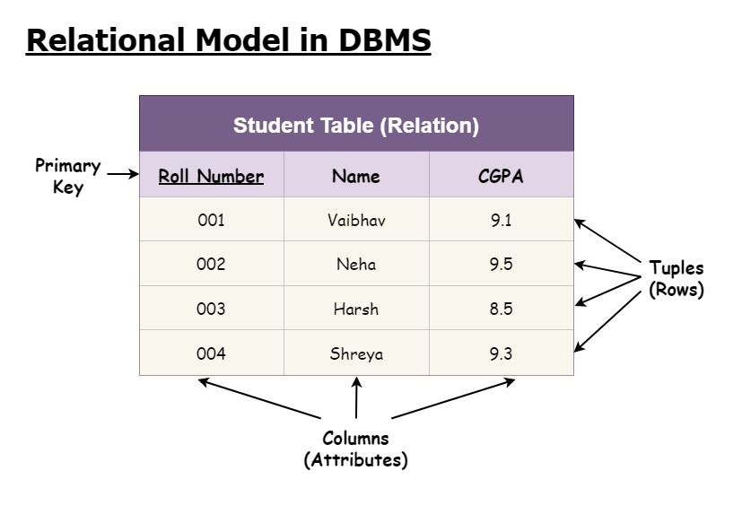
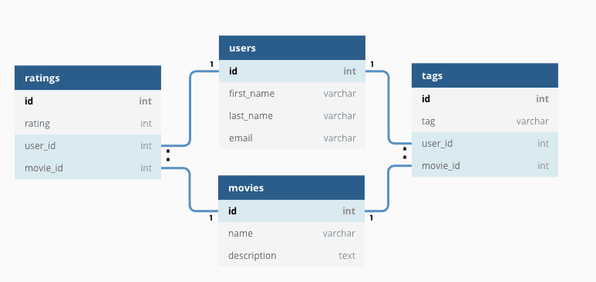
The database approach The relational database model

Slide 31
Index
Opening Case
Introduction
Managing Data
The Database Approach
Big Data
Data warehouses and data marts
Knowledge management

Slide 32
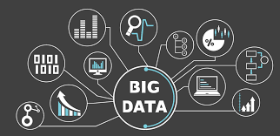
Big Data Introduction
Data has increased at rapid pace from multiple sources.
The world generates around one zettabyte (10^21 bytes)of data each year
In 2000 around 25% of all data was digital. Now (2024) around 99% of all data is digital
This superabundance of data os called BIG DATA

Slide 33
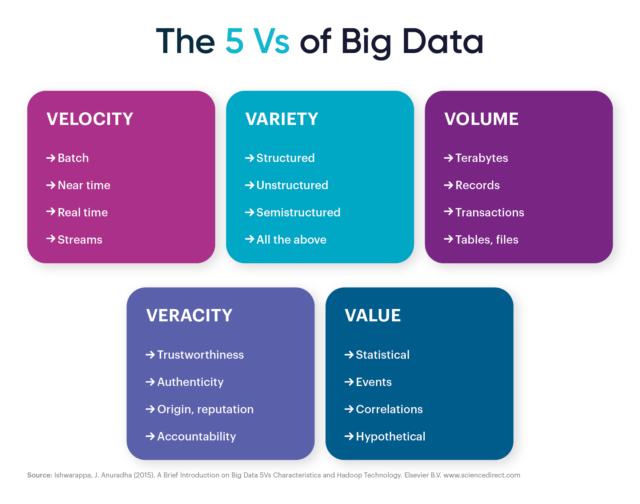
Big Data Defining big data - Characteristics
Not easy, but there are characteristics we can associate it to (the 5 “Vs”):
Volume
Variety
Veracity
Velocity
Value

Slide 34
Big Data Defininf Big Data – what it consists of
Big data consists of 4 types:
Traditional enterprise Data
Machine-generated/sensor Data
Social Data
Images/Video

Slide 35
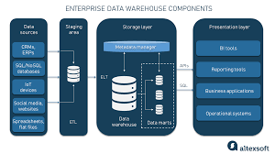
Big Data Traditional Enterprise Data
Customer information from customer relationship management systems, transactional enterprise resource planning data, Web store transactions, operations data, and general ledger data.

Slide 36

Big Data Machine-generated/sensor Data
Smart meters; manufacturing sensors; sensors integrated into smartphones, automobiles, airplane engines, and industrial machines; equipment logs; and trading systems data

Slide 37

Big Data Social Data
Customer feedback comments; microblogging sites such as Twitter; and social media sites such as Facebook, YouTube, and LinkedIn.

Slide 38

Big Data Images/Videos

Slide 39

Big Data Issues
Despite it’s extreme value, there are issues to face:
Trustworthy Sources?
Dirty Data?
Continuous Changes to data

Slide 40

Big Data Managing Big Data
Big Data allows us to unlock insight
Big Data enables rapid and accurate identification of business trends, disease prevention, crime tracking, and more through advanced analysis.
Advancements in hardware, cloud computing, and open-source software make Big Data processing affordable for organizations of all sizes.

Slide 41
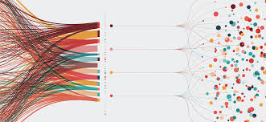
Big Data Managing Big Data
Data management has evolved
Organizations initially integrated Data silos into databases and developed data warehouses for decision-making.
The emergence of NoSQL databases, like Hadoop and MapReduce, allows for the manipulation of structured, unstructured, and inconsistent data, particularly suited for Big Data analysis.

Slide 42

Big Data How to use Big Data
So, how can we use Big Data to gain insights?
Modern organizations must manage Big Data and gain value from it. They can employ several strategies to achieve this objective:
Making Big Data available
Enhancing Performance through Experimentation
Microsegmentation for precision marketing
Innovating Business Models with telematics
Maximizing Analytical Potencial

Slide 43

Big Data How to use Big Data
Making big data available (open Data)
Open data initiatives provide economic benefits by making vast amounts of government data available for analysis and innovation.
Companies like those in the Open Data 500 study build business models around analyzing open government data, contributing to economic growth.

Slide 44

Big Data How to use Big Data
Enhancing Performance through Experimentation
Big Data enables organizations like Amazon, Google, and Etsy to conduct controlled experiments, such as A/B testing, to optimize website performance and customer engagement.
Case studies, like the one from Etsy, demonstrate how analyzing customer behavior and implementing changes based on data insights can lead to improved outcomes.

Slide 45
Big Data How to use Big Data
Microsegmentation for precision marketing
Microsegmentation, enabled by Big Data analytics, allows companies like Paytronix Systems to tailor loyalty and rewards programs to individual customers or small groups based on detailed customer data.
By leveraging Big Data, businesses can enhance customer satisfaction and profitability by delivering personalized experiences and offers.

Slide 46

Big Data How to use Big Data
Innovating Business Models with telematics
Companies leverage Big Data from telematics sensors on vehicles to improve vehicle maintenance, driver performance, and risk analysis.
Sharing this data with insurance carriers enables the development of new pricing models based on real-time insights, leading to cost savings and safety improvements.

Slide 47
Big Data How to use Big Data
Maximizing Analytical Potencial
Big Data enables organizations to analyze entire datasets rather than relying solely on sampling, enhancing the accuracy and depth of insights.
Overcoming biases inherent in traditional sampling methods, such as political polling, ensures more accurate and comprehensive analysis of phenomena.

Slide 48

Big Data Big Data in functional areas of na organization
Big Data Across Organizational Functions:
How is it used and applied in multiple departments?
Driving Efficiency and Innovation:
Does it allow for better efficiency, and does it foster innovation?

Slide 49

Big Data Big Data in functional areas of na organization
Leveraging Big Data in Human Resources:
1
Companies like Caesars Entertainment use Big Data analysis of health-insurance claims to manage employee benefits effectively, resulting in significant cost savings.
Innovative approaches, such as those by Catalyst IT Services, utilize Big Data for hiring decisions, improving candidate selection processes and reducing turnover rates.
Enhancing Product Development with Big Data Insights:
2
Ford Motor Company utilized text-mining algorithms to gather customer feedback from online forums, informing the introduction of a new turn indicator feature across its product lineup.
Big Data enables companies to understand customer preferences and trends, facilitating the development of products that meet consumer needs more effectively.

Slide 50

Big Data Big Data in functional areas of na organization
Optimizing Operations through Data-driven Decisions:
1
Organizations like UPS leverage Big Data from sensors in delivery vehicles to optimize operations, reducing fuel consumption and improving route efficiency.
Data analysis enables companies to gain insights into operational performance, leading to cost savings and enhanced productivity.
Personalizing Marketing Strategies with Big Data:
2
InterContinental Hotels Group (IHG) utilizes Big Data to personalize marketing messages for its Priority Club rewards program members, resulting in higher customer conversions and engagement.
Big Data empowers marketers to tailor campaigns based on customer preferences and behavior, driving more targeted and effective marketing efforts.
Improving Government Operations with Smart Transport Solutions:
3
Cities like London leverage Big Data from traffic cameras and sensors to enhance urban transport systems, reducing congestion and improving the overall urban transport user experience.
Analyzing Big Data enables governments to implement real-time traffic management strategies, leading to more efficient and sustainable urban mobility solutions.

Slide 51
Index
Opening Case
Introduction
Managing Data
The Database Approach
Big Data
Data warehouses and data marts
Knowledge management

Slide 52
Data warehouses and Data marts Introduction
Today, the most successful companies are those that can respond quickly and flexibly to market changes and opportunities. A key to this response is the effective and efficient use of data and information by analysts and managers. The challenge is to provide users with access to corporate data so they can analyze the data to make better decisions
Data warehouses and data marts are the solution!

Slide 53
Data warehouses and Data marts Introduction
Empowering Decision-Making with Data:
Successful companies leverage data and information to respond quickly to market changes and opportunities, enabling analysts and managers to make informed decisions.
Tools like SQL and query-by-example (QBE) facilitate access to corporate data, allowing users to analyze information and gain insights for better decision-making.
Building Data Warehouses for Enhanced Data Management:
Organizations establish data warehouses and data marts to address challenges related to data organization, query complexity, and database performance.
Data warehouses provide a structured and optimized environment for accessing and analyzing large datasets, improving efficiency and reducing processing time.
Utilizing Tools for Efficient Data Access and Analysis:
Companies deploy various tools and technologies to enhance user access, analysis, and querying of data within data warehouses and data marts.
These tools streamline data retrieval processes and improve overall usability, contributing to more effective decision-making and business intelligence.

Slide 54

Data warehouses and Data marts Characteristics
Organized by business dimension or subject
Use online Analytical processing (OLAP)
Integrated
Time variant
Nonvolatile
Multidimensional

Slide 55
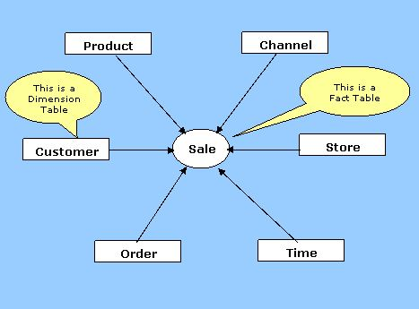
Characteristics Organized by business dimension or subject
Data are organized by subject—for example, by customer, vendor, product, price level, and region. This arrangement differs from transactional systems, where data are organized by business process such as order entry, inventory control, and accounts receivable.

Slide 56

Characteristics OLAP
Organizational databases primarily use online transaction processing (OLTP) for speedy and efficient handling of business transactions. On the other hand, data warehouses and data marts utilize online analytical processing (OLAP) to analyze accumulated data for decision-making purposes by end users.

Slide 57

Characteristics Integrated
Data are collected from multiple systems and are then integrated around subjects. For example, customer data may be extracted from internal (and external) systems and then integrated around a customer identifier, thereby creating a comprehensive view of the customer

Slide 58
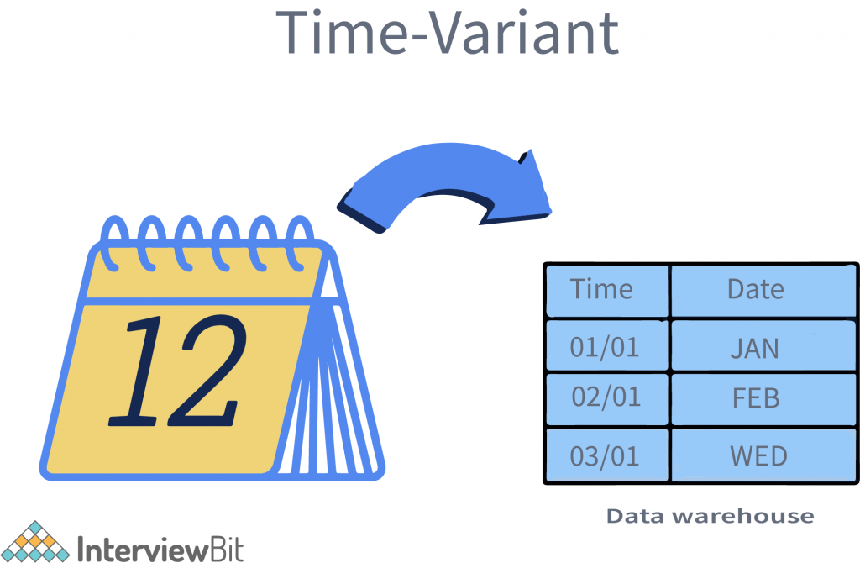
Characteristics Time variant
Data warehouses and data marts maintain historical data; that is, data that include time as a variable. Unlike transactional systems, which maintain only recent data (such as for the last day, week, or month), a warehouse or mart may store years of data.
Organizations use historical data to detect deviations, trends, and long-term relationships.

Slide 59
Characteristics Nonvolatile
Data warehouses and data marts are nonvolatile—that is, users cannot change or update the data. Therefore, the warehouse or mart reflects history, which, as we just saw, is critical for identifying and analyzing trends. Warehouses and marts are updated, but through IT-controlled load processes rather than by users.

Slide 60
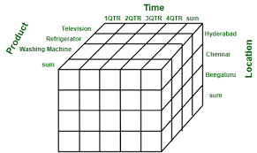
Characteristics Multidimensional
Typically, the data warehouse or mart uses a multidimensional data structure. Recall that relational databases store data in two-dimensional tables. In contrast, data warehouses and marts store data in more than two dimensions. For this reason, the data are said to be stored in a multidimensional structure. A common representation for this multidimensional structure is the data cube.

Slide 61
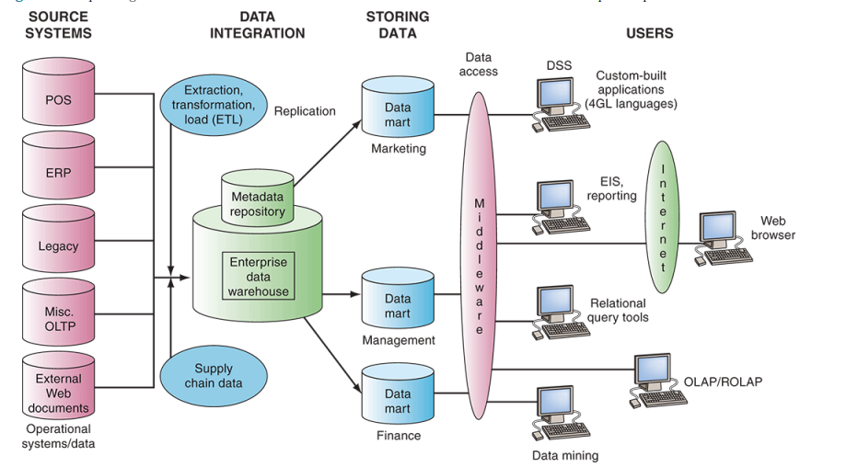
Data warehouses and Data marts Generic environment

Slide 62
Data warehouses and Data marts Generic environment

Slide 63

Data warehouses and Data marts Generic environment - Sources
Source systems in data warehouses are diverse, including operational systems, enterprise resource planning (ERP) systems, website data, and third-party data.
Common sources are operational databases, often relational, but data warehouses represent data in multidimensional formats like data cubes.
Despite potential issues like bad data and poor documentation, these source systems provide crucial data for decision-making and analysis in organizations.

Slide 64
Data warehouses and Data marts Generic environment

Slide 65
Data warehouses and Data marts Generic environment – Data Integration
Data integration is vital for extracting, transforming, and loading data into a data mart or warehouse, commonly referred to as ETL (extract, transform, load). This process can also be ELT, where data are extracted, loaded, and then transformed.
Extraction can be done through SQL queries or commercial software, which simplifies specifying tables, mapping data movement, scheduling, and performing required transformations.
Integration involves aligning data from different systems around common keys, like customer identification numbers, to create comprehensive views, such as a bank's 360-degree view of customer interactions across various touchpoints.

Slide 66
Data warehouses and Data marts Generic environment

Slide 67

Data warehouses and Data marts Generic environment – Data storing
Organizations have various options for storing decision-support data.
The most common approach is a central enterprise data warehouse, providing a single version of truth accessible to all users.
Alternatively, independent data marts store data for specific applications, but they can be costly to maintain and may lack consistency.
The hub and spoke architecture combines a central warehouse with dependent data marts, ensuring a single version of truth while catering to specific application needs for faster response times.
This setup allows users to analyze data intuitively based on business dimensions and measures.

Slide 68

Data warehouses and Data marts Generic environment - Metadata
Metadata, or data about the data, is crucial for both IT personnel and users in a data warehouse.
IT personnel rely on metadata for details about data sources, database structures, refresh schedules, and usage metrics.
Users require metadata for data definitions, report and query tools, report distribution details, and help desk contacts.

Slide 69

Data warehouses and Data marts Generic environment – Data quality
Data quality in the warehouse is critical for user trust and utilization.
Often, source system data is poor, requiring improvement before integration. While data-cleansing software can help, enhancing source system data quality is the preferred long-term solution. This necessitates business owners taking responsibility for implementing changes. For instance, a hotel chain faced zip code errors due to clerical input, highlighting the need for proactive data management at the source.

Slide 70
Data warehouses and Data marts Generic environment

Slide 71
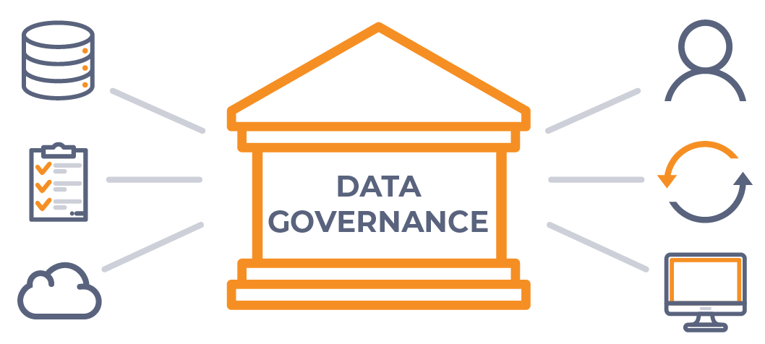
Data warehouses and Data marts Generic environment - Governance
Organizations must implement governance for effective BI, involving senior-level and middle management committees to align business and BI strategies, prioritize projects, and allocate resources. Operational committees address data definitions and problem-solving, with collaboration between business users and IT personnel crucial for success.

Slide 72
Data warehouses and Data marts Generic environment – Users/Reporting
Business Value of BI:
Loading data into a data mart or warehouse marks the beginning of obtaining business value from BI.
Users:
Various users of BI include IT developers, frontline workers, analysts, managers, executives, and external stakeholders. They can be either information producers or consumers.
Success Stories:
Many successful data warehousing applications have been reported by companies. Success stories and case studies are available on vendor websites like NCR Corp. and Oracle, as well as resources like the Data Warehouse Institute.
Benefits of Data Warehousing:
Quick and easy access to needed data through web browsers.
Extensive analysis capabilities previously not possible.
Consolidated view of organizational data.
Impact on Business:
Benefits include improved business knowledge, competitive advantage, enhanced customer service, better decision-making, and streamlined business processes.

Slide 73
Data warehouses and Data marts EDW possesses problems
Challenges with Enterprise Data Warehouses (EDWs):
Despite their benefits, EDWs can be inflexible and struggle to manage new data sources, such as streaming data and social media content.
EDWs require a predefined schema, limiting their ability to handle ad hoc queries and adapt to evolving business needs.
Transition to Data Lakes:
The emergence of systems like Apache Hadoop has enabled organizations to implement data lakes, which serve as central repositories for all organizational data.
Data lakes accept data in any format, structured or unstructured, providing a more flexible and scalable solution compared to traditional EDWs.

Slide 74

Data lakes
Benefits of Data Lakes:
Data lakes offer several advantages, including the ability to derive value from unlimited types of data and the flexibility to query data without constraints.
By eliminating the need for upfront data modeling, data lakes streamline data ingestion and analysis processes, facilitating faster insights and decision-making.
Integration with Enterprise Data Warehouses:
Organizations often use both EDWs and data lakes, leveraging the strengths of each depending on the nature of the data and the complexity of the queries.
While EDWs excel at handling structured data and answering predefined queries, data lakes are better suited for analyzing unstructured and evolving data sources.

Slide 75
Index
Opening Case
Introduction
Managing Data
The Database Approach
Big Data
Data warehouses and data marts
Knowledge management

Slide 76

Knowledge Management
As it was stated before, these systems that have been developed alow someone or a group of people to gather data, transform it and gather insights/knowledge.
But what exactly is knowledge?
Why is it usefull in decision making scenarios?

Slide 77
Knowledge Management What is knowledge?

Slide 78
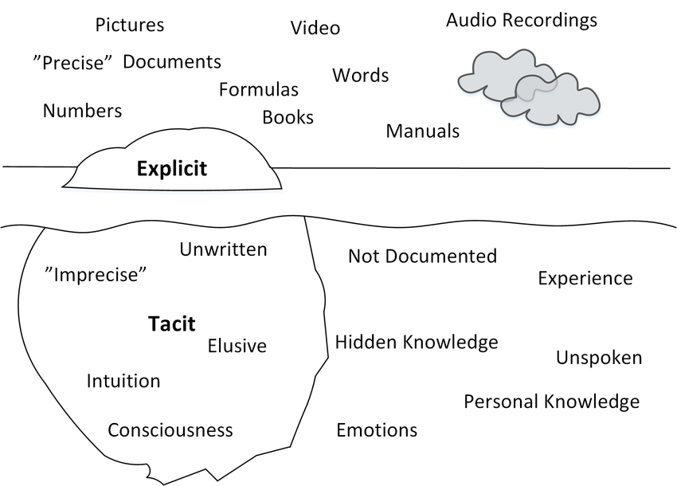
Knowledge Management Explicit vs Tacit knowledge
Explicit knowledge
Formal, objective, and can be written down easily. It's the type of information you typically find in books or documents.
Tacit knowledge
More personal and subjective. It's based on individual experiences, intuition, and insights that are hard to put into words.

Slide 79
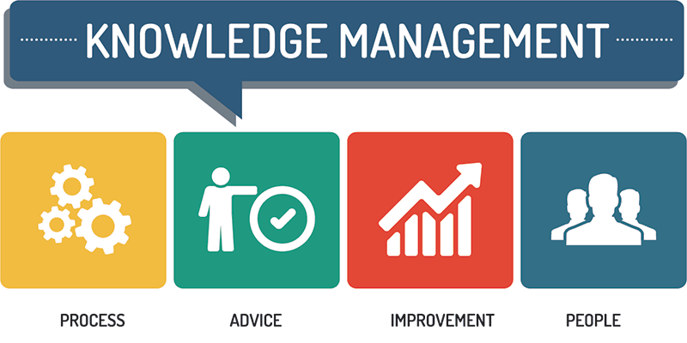
Knowledge Management Knowledge Management Systems
Evolution of Knowledge Management:
Historically, management information systems focused on explicit knowledge, but organizations now recognize the importance of integrating tacit knowledge into formal systems.
Knowledge management systems (KMSs) leverage modern information technologies to systematize, enhance, and expedite knowledge management within and across organizations.

Slide 80
Knowledge Management Knowledge Management Systems
Benefits of Knowledge Management Systems (KMSs):
KMSs facilitate the sharing of best practices, improving organizational performance by making valuable expertise widely accessible.
Enhanced access to tacit knowledge leads to benefits such as improved customer service, more efficient product development, and higher employee morale and retention.
Challenges in Implementing KMSs:
Encouraging employees to share personal tacit knowledge requires fostering a knowledge-sharing culture and rewarding contributions.
Continuous maintenance and updating of the knowledge base are essential to ensure relevance and effectiveness.
Organizations must be willing to invest resources in the ongoing operations and development of KMSs to realize long-term benefits.

Slide 81
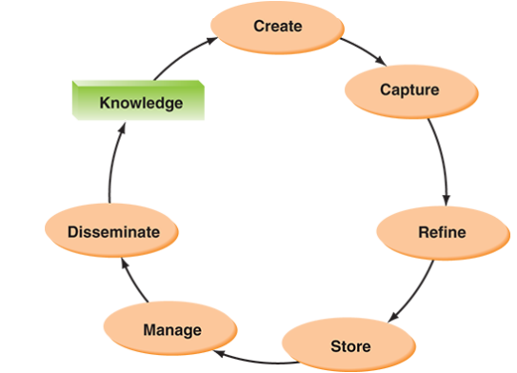
Knowledge Management The KMS cycle
The cycle refers to 6 steps:
Create knowledge
Capture Knowledge
Refine Knowledge
Store knowledge
Manage Knowledge
Disseminate knowledge

Slide 82

Knowledge Management The KMS cycle - Create
Knowledge is created as people determine new ways of doing things or develop know-how. Sometimes external knowledge is brought in

Slide 83

Knowledge Management The KMS cycle - Capture
New knowledge must be identified as valuable and be presented in a reasonable way

Slide 84

Knowledge Management The KMS cycle - Refine
New knowledge must be placed in context so that it is actionable. This is where tacit qualities (human insights) must be captured along with explicit facts

Slide 85

Knowledge Management The KMS cycle - Store
Useful knowledge must then be stored in a reasonable format in a knowledge repository so that other people in the organization can access it.

Slide 86

Knowledge Management The KMS cycle - Manage
Like a library, the knowledge must be kept current. Therefore, it must be reviewed regularly to verify that it is relevant and accurate

Slide 87

Knowledge Management The KMS cycle - Disseminate
Knowledge must be made available in a useful format to anyone in the organization who needs it, anywhere and any time.

Slide 88

Fim
Perguntas?

